Slide 1
Local Image Features
Machine Learning and Computer Vision
Xinggang Wang （王兴刚）
xgwang@hust.edu.cn
华中科技大学
Acknowledgment: Many slides from James Hays, Derek Hoiem and Grauman&Leibe 2008 AAAI Tutorial

Slide 2
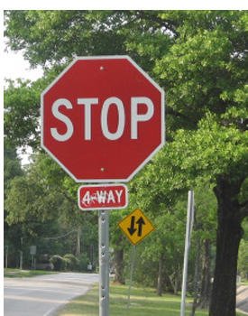
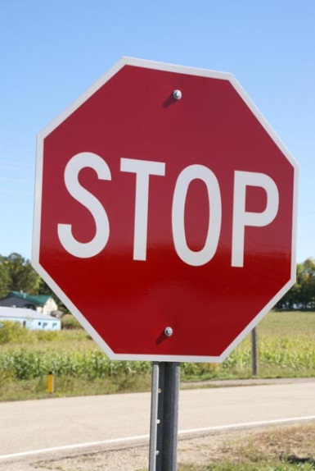
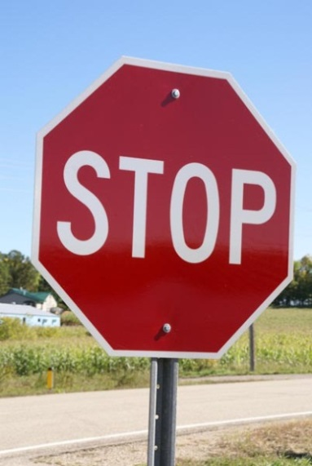
Matching / Correspondence: matching points, patches, edges, or regions across images
≈

Slide 3
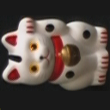
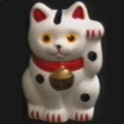
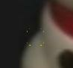
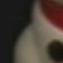
Overview of Keypoint Matching
1. Find a set of distinctive key- points
A₁
B₃
2. Define a region around each keypoint
A₂
A₃
B₁
B₂
3. Extract and normalize the region content
4. Compute a local descriptor from the normalized region
5. Match local descriptors

Slide 4
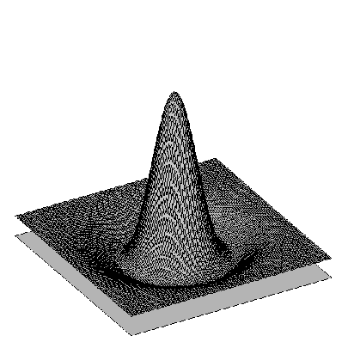
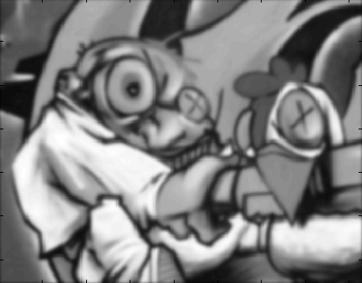

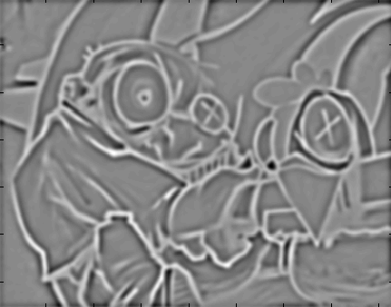
Difference-of-Gaussian (DoG)
-
=

Slide 5
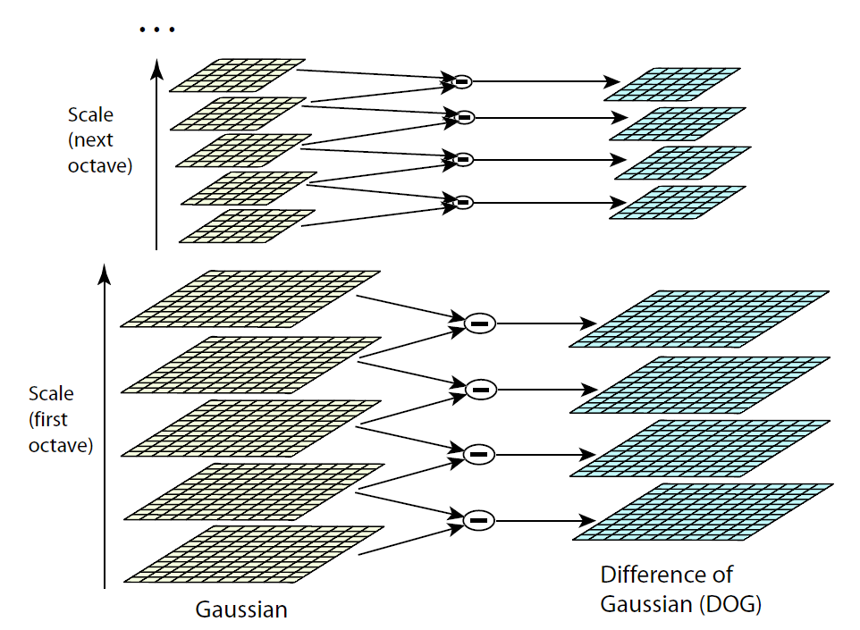


DoG – Efficient Computation
Computation in Gaussian scale pyramid
Sampling with step σ⁴ =2
σ
σ
σ
Original image
σ

Slide 6
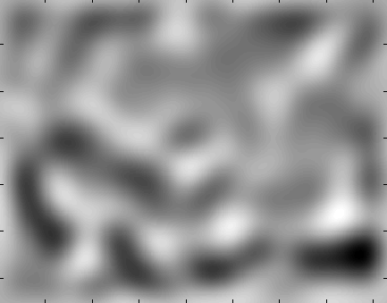
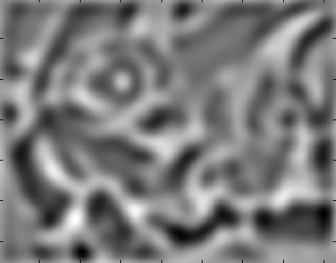
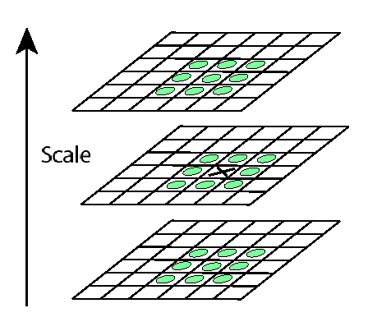

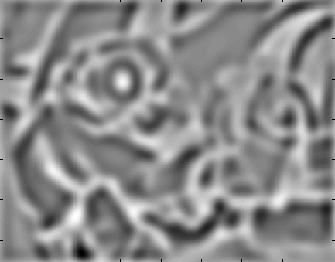
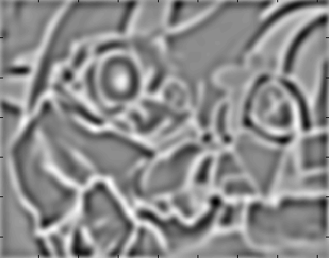
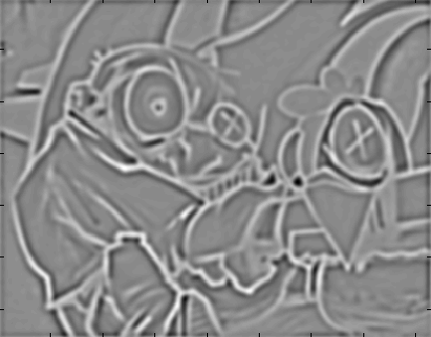
Find local maxima in position-scale space of Difference-of-Gaussian
σ⁵
σ⁴
σ³
σ²
⇒ List of (x, y, s)
σ
Notes:
Blob detector is distinct from harris corner detector

Slide 7
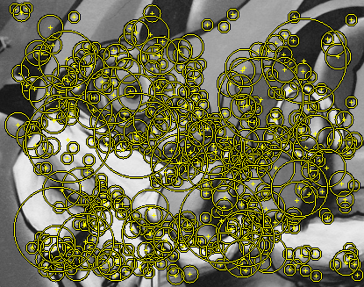
Results: Difference-of-Gaussian

Slide 8
Orientation Normalization
Compute orientation histogram
Select dominant orientation
Normalize: rotate to fixed orientation
[Lowe, SIFT, 1999]
0
2
π

Slide 9
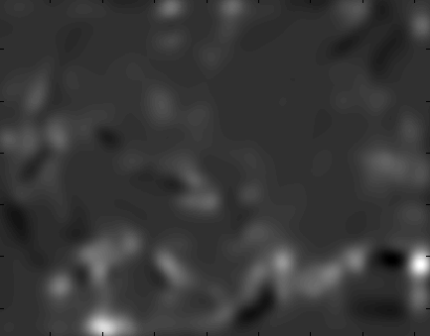
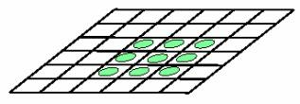
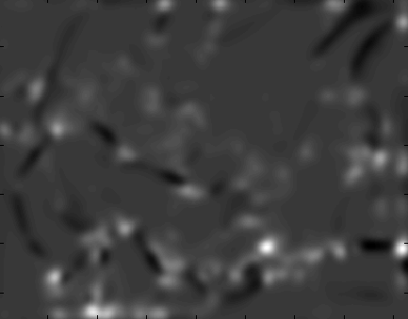

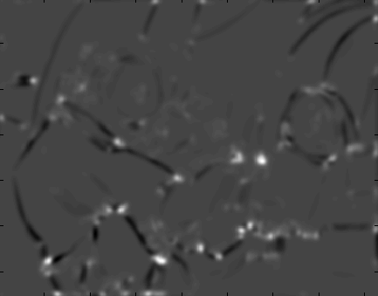
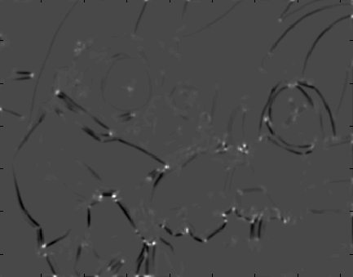
Harris-Laplace [Mikolajczyk ‘01]
Initialization: Multiscale Harris corner detection
σ⁴
σ³
σ²
σ
Computing Harris function
Detecting local maxima

Slide 10
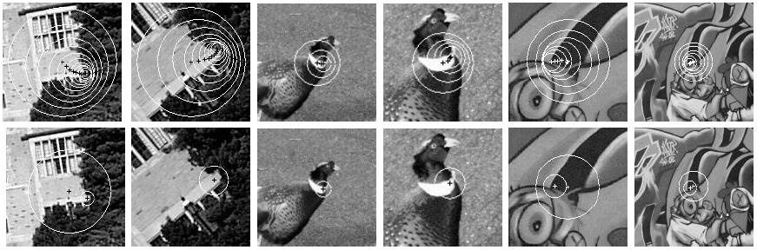
Harris-Laplace [Mikolajczyk ‘01]
Initialization: Multiscale Harris corner detection
Scale selection based on Laplacian (same procedure with Hessian ⇒ Hessian-Laplace)
Harris points
Harris-Laplace points

Slide 11
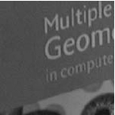

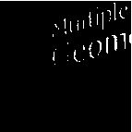
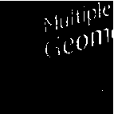
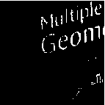
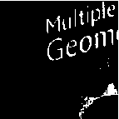
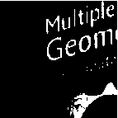
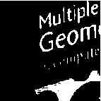

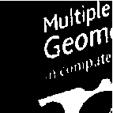



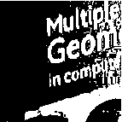
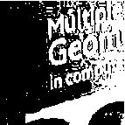
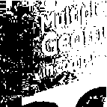
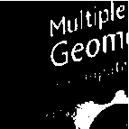
Maximally Stable Extremal Regions [Matas ‘02]
Based on Watershed segmentation algorithm
Select regions that stay stable over a large parameter range

Slide 12
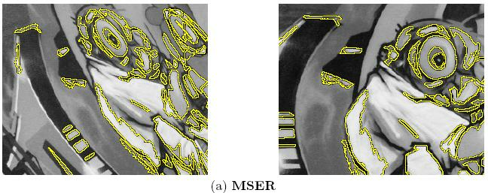
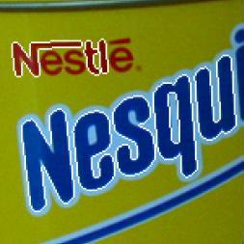
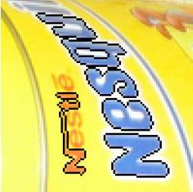
Example Results: MSER

Slide 13
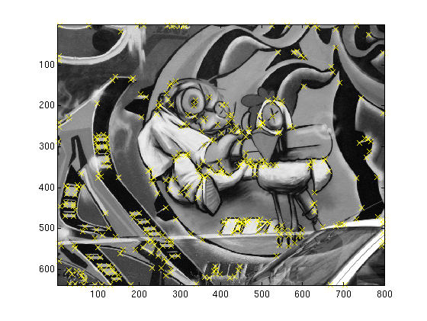
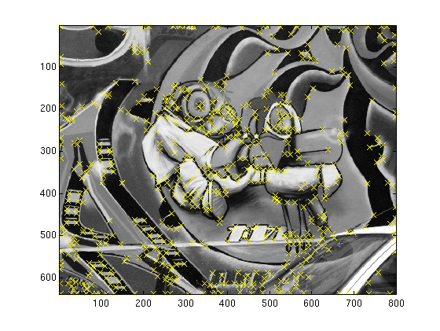
Comparison
Hessian
Harris
MSER
LoG

Slide 14
Available at a web site near you…
For most local feature detectors, executables are available online:
http://www.robots.ox.ac.uk/~vgg/research/affine
http://www.cs.ubc.ca/~lowe/keypoints/
http://www.vision.ee.ethz.ch/~surf

Slide 15
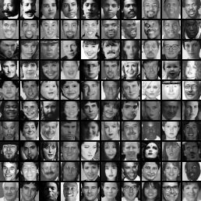
Image representations
Templates
Intensity, gradients, etc.
Histograms
Color, texture, SIFT descriptors, etc.

Slide 16
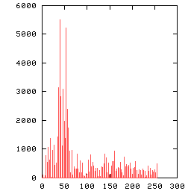
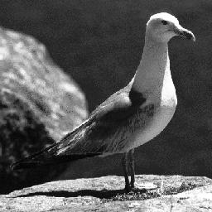
Image Representations: Histograms
Global histogram
Represent distribution of features
Color, texture, depth, …
Space Shuttle Cargo Bay
Images from Dave Kauchak

Slide 17
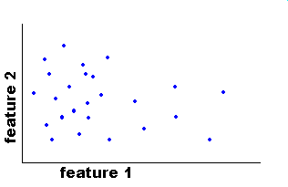
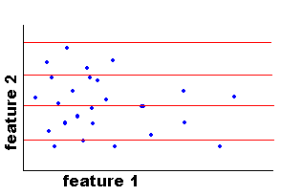
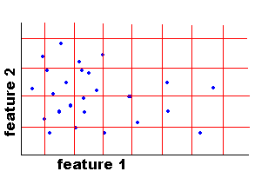
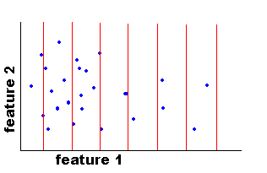
Image Representations: Histograms
Histogram: Probability or count of data in each bin
Joint histogram
Requires lots of data
Loss of resolution to avoid empty bins
Marginal histogram
Requires independent features
More data/bin than joint histogram
Images from Dave Kauchak

Slide 18
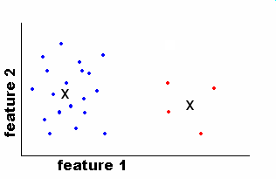
Image Representations: Histograms
Clustering
EASE Truss Assembly
Use the same cluster centers for all images
Space Shuttle Cargo Bay
Images from Dave Kauchak

Slide 19
Computing histogram distance
Histogram intersection (assuming normalized histograms)
Chi-squared Histogram matching distance
Cars found by color histogram matching using chi-squared

Slide 20
Histograms: Implementation issues
Quantization
Grids: fast but applicable only with few dimensions
Clustering: slower but can quantize data in higher dimensions
Matching
Histogram intersection or Euclidean may be faster
Chi-squared often works better
Earth mover’s distance is good for when nearby bins represent similar values
Few Bins
Need less data
Coarser representation
Many Bins
Need more data
Finer representation

Slide 21
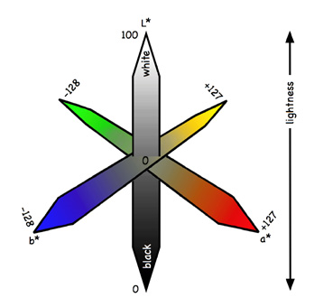

What kind of things do we compute histograms of?
Color
Texture (filter banks or HOG over regions)
L*a*b* color space
HSV color space

Slide 22


What kind of things do we compute histograms of?
Histograms of oriented gradients
SIFT – Lowe IJCV 2004

Slide 23


SIFT vector formation
Computed on rotated and scaled version of window according to computed orientation & scale
resample the window
Based on gradients weighted by a Gaussian of variance half the window (for smooth falloff)

Slide 24
SIFT vector formation
4x4 array of gradient orientation histogram weighted by magnitude
8 orientations x 4x4 array = 128 dimensions
Motivation: some sensitivity to spatial layout, but not too much.
showing only 2x2 here but is 4x4

Slide 25
Reduce effect of illumination
128-dim vector normalized to 1
Threshold gradient magnitudes to avoid excessive influence of high gradients
after normalization, clamp gradients >0.2
renormalize

Slide 26

Local Descriptors: Shape Context
Count the number of points inside each bin, e.g.:
Count = 4
...
Count = 10
Log-polar binning: more precision for nearby points, more flexibility for farther points.
Belongie & Malik, ICCV 2001
K. Grauman, B. Leibe

Slide 27

Shape Context Descriptor

Slide 28

Self-similarity Descriptor
Matching Local Self-Similarities across Images and Videos, Shechtman and Irani, 2007

Slide 29

Self-similarity Descriptor
Matching Local Self-Similarities across Images and Videos, Shechtman and Irani, 2007

Slide 30

Self-similarity Descriptor
Matching Local Self-Similarities across Images and Videos, Shechtman and Irani, 2007

Slide 31

Local Descriptors: SURF
Fast approximation of SIFT idea
Efficient computation by 2D box filters & integral images ⇒ 6 times faster than SIFT
Equivalent quality for object identification
GPU implementation available
Feature extraction @ 200Hz (detector + descriptor, 640×480 img)
http://www.vision.ee.ethz.ch/~surf
[Bay, ECCV’06], [Cornelis, CVGPU’08]

Slide 32

Lowe’s SIFT Matching Demo

Slide 33







Multi-view matching
?
vs
…
Matching two given views for depth
Search for a matching view for recognition
Kristen Grauman

Slide 34
Local Descriptors
Most features can be thought of as templates, histograms (counts), or combinations
The ideal descriptor should be
Robust
Distinctive
Compact
Efficient
Most available descriptors focus on edge/gradient information
Capture texture information
Color rarely used

Slide 35
Choosing a detector
What do you want it for?
Precise localization in x-y: Harris
Good localization in scale: Difference of Gaussian
Flexible region shape: MSER
Best choice often application dependent
Harris-/Hessian-Laplace/DoG work well for many natural categories
MSER works well for buildings and printed things
Why choose?
Get more points with more detectors
There have been extensive evaluations/comparisons
[Mikolajczyk et al., IJCV’05, PAMI’05]
All detectors/descriptors shown here work well

Slide 36

Comparison of Keypoint Detectors
Tuytelaars Mikolajczyk 2008

Slide 37
Choosing a descriptor
Again, need not stick to one
For object instance recognition or stitching, SIFT or variant is a good choice

Slide 38

Things to remember
Keypoint detection: repeatable and distinctive
Corners, blobs, stable regions
Harris, DoG
Descriptors: robust and selective
spatial histograms of orientation
SIFT

Slide 39
Next time
Feature tracking

